Slide 1
40 Years of a Deadly Legal Anomaly
Roe v. Wade
Doe v. Bolton
Casey

Slide 2

lldf.org

Slide 3
From Dred Scott, 1857:
When a strict interpretation of the Constitution, according to the
fixed rules which govern the interpretation of laws, is abandoned, and the theoretical opinions of individuals are allowed to control its meaning, we no longer have a Constitution; we are under government of individual men, who for the time being have power to declare what the Constitution is, according to their own views of what it ought to mean.

Slide 4
On a sensitive issue such as this, involving as it does issues on which men could heatedly differ, I cannot accept the Court’s clear power of choice by interposing a constitutional barrier to the state efforts to protect human life by investing mothers and doctors with the constitutional right to exterminate it.
DOE DISSENT

Slide 5
It is inherently manipulable and will prove hopelessly unworkable in practice.
          Casey Dissent

Slide 6
The candid citizen must confess that if the policy of the Government upon vital questions affecting the whole people is to be irrevocably fixed by decisions of the Supreme Court,…the people will have ceased to be their own rulers, having to that extent practically resigned their Government into the hands of that eminent tribunal.
  Abraham Lincoln at the First Inaugural Address, March 4, 1861

Slide 7
You can read Sandra Cano’s testimony before the Senate Committee on the Judiciary at
http://wonderfullymade
ministry.com/testimony.htm,
              June 23, 2005

Slide 8
“I think it’s safe to say that the entire abortion industry is based on a lie…. I am dedicated to spending the rest of my life undoing the law that bears my name.”
Roe, Norman McCorvey

Slide 9
…the frightful extent of this crime (abortion) is found in the grave defects of our laws, both common and statute as regards the independent and actual existence of the child before birth, as a living being. The errors, which are sufficient in most instances to prevent conviction, are based, and only based, upon mistaken and exploded medical dogma.
AMA Committee on Criminal Abortion, 1857

Slide 10
The committee then offered resolutions protesting “against such unwarrantable destruction of human life.”

Slide 11
Archibald Cox — JFK's Solicitor General, Harvard Law School
“The failure to confront the issue in principled terms leaves the opinion to read like a set of hospital rules and regulations…. Neither historian, nor layman, nor lawyer will be persuaded that all the prescriptions of Justice Blackmun are part of the Constitution”
The Role of the Supreme Court in American Government, pp. 113-114 (1976)

Slide 12
Kermit Roosevelt — University of Pennsylvania Law School
“[I]t is time to admit in public that, as an example of the practice of constitutional opinion writing, Roe is a serious disappointment. You will be hard-pressed to find a constitutional law professor, even among those who support the idea of constitutional protection for the right to choose, who will embrace the opinion itself rather than the result.
“This is not surprising. As constitutional argument, Roe is barely coherent. The court pulled its fundamental right to choose more or less from the constitutional ether. It supported that right via a lengthy, but purposeless, cross-cultural historical review of abortion restrictions and a tidy but irrelevant refutation of the straw-man argument that a fetus is a constitutional ‘person’ entitled to the protection of the 14th Amendment.
…. “By declaring an inviolable fundamental right to abortion, Roe short-circuited the democratic deliberation that is the most reliable method of deciding questions of competing values.”
“Shaky Basis for a Constitutional ‘Right,”” Washington Post, January 22, 2003.

Slide 13
Michael Kinsley, American political journalist, commentator, television host, and pundit
“Against all odds (and, I’m afraid, against all logic), the basic holding of Roe v. Wade is secure in the Supreme Court.
“…a freedom of choice law would guarantee abortion rights the correct way, democratically, rather than by constitutional origami.”
          “Bad Choice” The New Republic, June 13, 1994
“Liberal judicial activism peaked with Roe v. Wade, the 1973 abortion decision….
“Although I am pro-choice, I was taught in law school, and still believe, that Roe v. Wade is a muddle of bad reasoning and an authentic example of judicial overreaching. I also believe it was a political disaster for liberals. Roe is what first politicized religious conservatives while cutting off a political process that was legalizing abortion state by state anyway.” “
      The Right’s Kind of Activism Washington Post, November 14, 2004

Slide 14
Jeffrey Rosen — Legal Affairs Editor, The New Republic
“In short, 30 years later, it seems increasingly clear that this pro-choice magazine was correct in 1973 when it criticized Roe on constitutional grounds. Its overturning would be the best thing that could happen to the federal judiciary, the pro-choice movement, and the moderate majority of the American people.
….
“Thirty years after Roe, the finest constitutional minds in the country still have not been able to produce a constitutional justification for striking down restrictions on early-term abortions that is substantially more convincing than Justice Harry Blackmun’s famously artless opinion itself. As a result, the pro-choice majority asks nominees to swear allegiance to the decision without being able to identify an intelligible principle to support it.”
            “Worst Choice” The New Republic February 24, 2003

Slide 15
Cass Sunstein — University of Chicago and a Democratic adviser on judicial nominations
“In the Court’s first confrontation with the abortion issue, it laid down a set of rules for legislatures to follow. The Court decided too many issues too quickly. The Court should have allowed the democratic processes of the states to adapt and to generate sensible solutions that might not occur to a set of judges.”
“The Supreme Court 1995 Term: FOREWORD: LEAVING THINGS UNDECIDED,” 110 Harvard Law Review 6, 20 (1996)

Slide 16
Alan Dershowitz — Harvard Law School
Roe v. Wade and Bush v. Gore “represent opposite sides of the same currency of judicial activism in areas more appropriately left to the
political processes…. Judges have no special competence, qualifications, or mandate to decide between equally compelling moral claims (as in the abortion controversy)…. [C]lear governing constitutional principles … are not present in either case.”
Supreme Injustice: How the High Court Hijacked Election 2000 (New York: Oxford) 2001, p. 194.

Slide 17
Benjamin Wittes — Washington Post
Roe “is a lousy opinion that disenfranchised millions of conservatives on an issue about which they care deeply.”
“Letting Go of Roe,” The Atlantic Monthly, Jan/Feb 2005.

Slide 18
John Hart Ely — Yale Law School, Harvard Law School, Stanford Law School
Roe “is not constitutional law and gives almost no sense of an obligation to try to be.”
….
“What is frightening about Roe is that this super-protected right is not inferable from the language of the Constitution, the framers’ thinking respecting the specific problem in issue, any general value derivable from the provisions they included, or the nation’s governmental structure. Nor is it explainable in terms of the unusual political impotence of the group judicially protected vis-à-vis the interest that legislatively prevailed over it.… At times the inferences the Court has drawn from the values the Constitution marks for special protection have been controversial, even shaky, but never before has its sense of an obligation to draw one been so obviously lacking.”
“The Wages of Crying Wolf: A Comment on Roe v. Wade,” 82 Yale Law Journal, 920, 935-937 (1973).

Slide 19
Edward Lazarus — Former clerk to Harry Blackmun.
“As a matter of constitutional interpretation and judicial method, Roe borders on the indefensible. I say this as someone utterly committed to the right to choose, as someone who believes such a right has grounding elsewhere in the Constitution instead of where Roe placed it, and as someone who loved Roe’s author like a grandfather.”
…. “What, exactly, is the problem with Roe? The problem, I believe, is that it has little connection to the Constitutional right it purportedly interpreted. A constitutional right to privacy broad enough to include abortion has no meaningful foundation in constitutional text, history, or precedent - at least, it does not if those sources are fairly described and reasonably faithfully followed.”
“The Lingering Problems with Roe v. Wade, and Why the Recent Senate Hearings on Michael McConnell’s Nomination Only Underlined Them” FindLaw Legal Commentary, Oct. 3, 2002

Slide 20
Ruth Bader Ginsburg — Associate Justice of the U.S. Supreme Court
“Roe, I believe, would have been more acceptable as a judicial decision if it had not gone beyond a ruling on the extreme statute before the court. … Heavy-handed judicial intervention was difficult to justify and appears to have provoked, not resolved, conflict.”
        North Carolina Law Review, 1985

Slide 21
Laurence Tribe — Harvard Law School. Lawyer for Al Gore in 2000.
“One of the most curious things about Roe is that, behind its own verbal smokescreen, the substantive judgment on which it rests is nowhere to be found.”
“The Supreme Court, 1972 Term—Foreword: Toward a Model of Roles in the Due Process of Life and Law,” 87 Harvard Law Review 1, 7 (1973).

Slide 22
There is an organization whose
mission is population control.
Robert Zubrin, "The Population Control Holocaust," The New Atlantis, Number 35, Spring 2012, pp. 33-54.

Slide 23
It’s founder, Margaret Sanger, was a well-documented proponent of eugenics and a celebrated Klu Klux Klan speaker.
Planned Parenthood, "History & Successes", (http://bit.ly/Qb19lE)
Margaret Sanger, "Birth Control is not merely of eugenic value, but is practically identical in ideal, with the final aims of Eugenics. " (http://bit.ly/KR67B8l) and "She [Margaret Sanger] read everything she could find on birth control and sexuality and immersed herself in the writings of Thomas Malthus [Eugenist], John Stuart [Eugenist] and Robert Owens [Eugenist] (Sanger, 1938, pp. 124-125). And she met Havelock Ellis [Eugenist], who became her mentor and her lover (Chesler, 1992, p. 120)."
(http://bit.ly/KEnGkB) by Jon Knowles with special thanks to Ellen Chesler, Planned Parenthood.

Slide 24
Planned Parenthood’s founder was one of the architects of the now infamous 1939 Negro Project, whose sole objective was to infiltrate the Black community by hiring Black preachers and presenting birth control as a health option for Black women.
Margaret Sanger (1938), "Margaret Sanger, An Autobiography," New York: W. W. Norton. pp. 361, 366–7. (http://bit.ly/10eyb77)
Tanya L. Green, "The Negro Project: Margaret Sanger's Eugenic Plan for Black Americans" (http://bit.ly/x9c2aV)

Slide 25


Slide 26
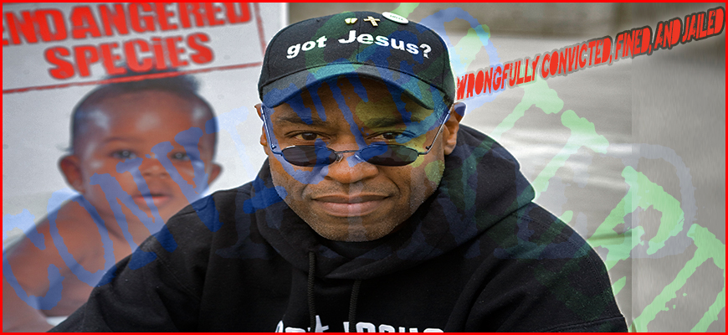
Reverend Walter Hoye
http://www.lldf.org/pastor-hoye/

Slide 27
lldf.org

